Slide 1
William Stallings
Computer Organization and Architecture
8th Edition
Chapter 4
Cache Memory

Slide 2
Characteristics
Location
Capacity
Unit of transfer
Access method
Performance
Physical type
Physical characteristics
Organisation

Slide 3
Memory: Location, Capacity, Unit of Transfer
1: Location: CPU, Internal, External
2: Capacity: Word size (The natural unit of organisation), Number of words or Bytes
3: Transfer Unit
  Internal
    Usually governed by data bus width
  External
    Usually a block which is much larger than a word
  Addressable unit
    Smallest location which can be uniquely addressed
    Cluster on M$ disks

Slide 4
Memory Access Methods (1)
Sequential
  Start at the beginning and read through in order
  Access time depends on location of data and previous location
  e.g. tape
Direct
  Individual blocks have unique address
  Access is by jumping to vicinity plus sequential search
  Access time depends on location and previous location
  e.g. disk

Slide 5
Memory Access Methods (2)
Random
  Individual addresses identify locations exactly
  Access time is independent of location or previous access
  e.g. RAM
Associative
  Data is located by a comparison with contents of a portion of the store
  Access time is independent of location or previous access
  e.g. cache

Slide 6
Memory Hierarchy
Registers
  In CPU
Internal or Main memory
  May include one or more levels of cache
  “RAM”
External memory
  Backing store

Slide 7

Memory Hierarchy - Diagram
DVD-RAM: 9.4GB two sided optical disk. DVD-RAM discs can be rewritten 100,000 times, 100 times more than either DVD-RW or DVD+RW, the other two rewritable DVD formats.
MO: Magneto Optical
WORM: write once read many time

Slide 8
Memory Performance Parameters
Access time
  Time between presenting the address and getting the valid data
Memory Cycle time
  Time may be required for the memory to “recover” before next access
  Cycle time is = access time + recovery time
Transfer Rate
  Rate at which data can be moved

Slide 9
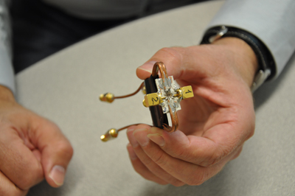
Physical Types
Semiconductor
  RAM
Magnetic
  Disk & Tape
Optical
  CD & DVD
Others
  Bubble
  (on magnetic surface)
  Hologram
  (3D magnetic media)
Data stored in magnetic holograms:
Data are stored in the form of magnetic bits and read out simultaneously as holographic images. Because the wavelengths of the spin waves are much shorter than those of light, the storage density of the memory has the potential to be much greater than systems based on optical holograms, and could someday be used to store very large amounts of information. http://physicsworld.com/

Slide 10
Physical Characteristics
Decay
Volatility
Erasable
Power consumption

Slide 11
Organisation
Physical arrangement of bits into words
Not always obvious
e.g. interleaved

Slide 12
The Bottom Line
How much?
  Capacity
How fast?
  Time is money
How expensive?

Slide 13
Hierarchy List
Registers
L1 Cache
L2 Cache
Main memory
Disk cache
Disk
Optical
Tape

Slide 14
So you want fast?
It is possible to build a computer which uses only static RAM (see later)
This would be very fast
This would need no cache
  How can you cache cache?
This would cost a very large amount

Slide 15
Locality of Reference
During the course of the execution of a program, memory references tend to cluster
e.g. loops

Slide 16
Cache (kind of definition)
Small amount of fast memory
Sits between normal main memory and CPU
May be located on CPU chip or the main memory module

Slide 17
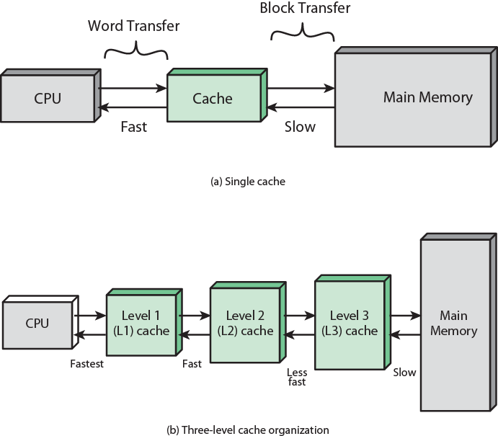
Cache and Main Memory

Slide 18
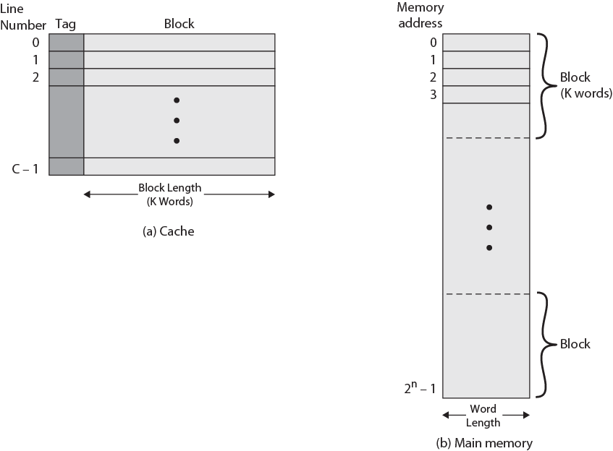
Cache/Main Memory Structure
RAM = 2^{n} words or bytes, cache = m = C K words or bytes
RAM = 2^{n} / K blocks,
cache = C lines of K words each
C > K => tall cache else short cache
Cache line bit size = w K + T bits where T is tag bits
w = number of bits per word for byte [w = 8]
T = log C or C = 2^{T}

Slide 19
Cache operation – overview
CPU requests contents of memory location
Check cache for this data
If present, get from cache (fast)
If not present, read required block from main memory to cache
And also deliver it to CPU
Cache includes tags to identify which block of main memory is in each cache line

Slide 20
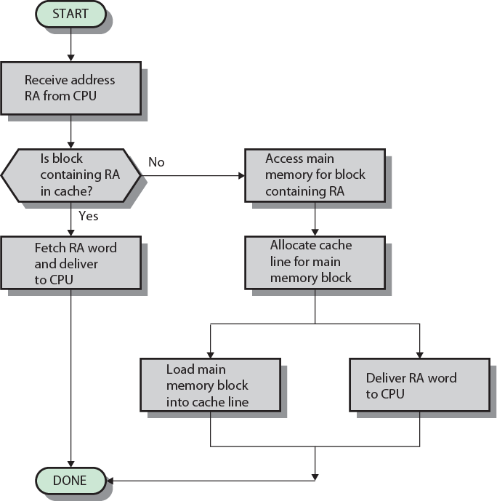
Cache Read Operation - Flowchart

Slide 21


Slide 22
Cache Design
Number of Caches (L1, L2, L3)
Addressing (Physical or Logical)
Size (How many total bytes or words, How many lines)
Block Size (How many bytes/words per line)
Mapping Function (Direct, Associative, set associative)
Replacement Algorithm
(LRU: Least recently used, FIFO, LFU: Least frequently used, Random)
Write Policy (Write through, Write back, Write once)

Slide 23
Cache Addressing
Where does cache sit?
  Between processor and virtual memory management unit
  Between MMU and main memory
Logical cache (virtual cache) stores data using virtual addresses
  Processor accesses cache directly, not through physical cache
  Cache access faster, before MMU address translation
  Virtual addresses use same address space for different applications
    Must flush cache on each context switch
Physical cache stores data using main memory physical addresses

Slide 24
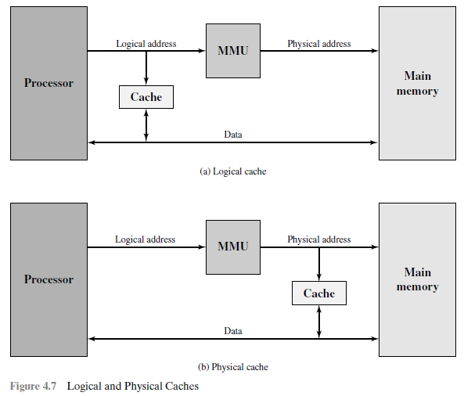
Logical vs Physical Cache

Slide 25
Size does matter
Cost
  More cache is expensive
Speed
  More cache is faster (up to a point)
  Checking cache for data takes time

Slide 26
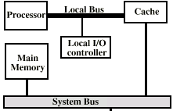
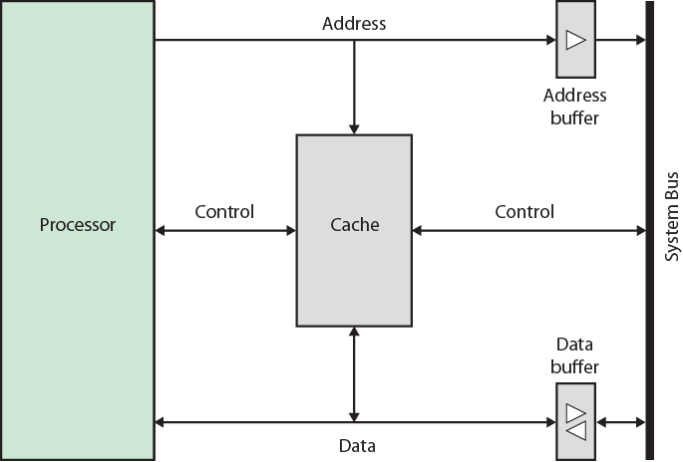
Typical Cache Organization

Slide 27
Comparison of Cache Sizes
Processor
Type
Year of Introduction
L1 cache
L2 cache
L3 cache
IBM 360/85
Mainframe
1968
16 to 32 KB
—
—
PDP-11/70
Minicomputer
1975
1 KB
—
—
VAX 11/780
Minicomputer
1978
16 KB
—
—
IBM 3033
Mainframe
1978
64 KB
—
—
IBM 3090
Mainframe
1985
128 to 256 KB
—
—
Intel 80486
PC
1989
8 KB
—
—
Pentium
PC
1993
8 KB/8 KB
256 to 512 KB
—
PowerPC 601
PC
1993
32 KB
—
—
PowerPC 620
PC
1996
32 KB/32 KB
—
—
PowerPC G4
PC/server
1999
32 KB/32 KB
256 KB to 1 MB
2 MB
IBM S/390 G4
Mainframe
1997
32 KB
256 KB
2 MB
IBM S/390 G6
Mainframe
1999
256 KB
8 MB
—
Pentium 4
PC/server
2000
8 KB/8 KB
256 KB
—
IBM SP
High-end server/ supercomputer
2000
64 KB/32 KB
8 MB
—
CRAY MTAb
Supercomputer
2000
8 KB
2 MB
—
Itanium
PC/server
2001
16 KB/16 KB
96 KB
4 MB
SGI Origin 2001
High-end server
2001
32 KB/32 KB
4 MB
—
Itanium 2
PC/server
2002
32 KB
256 KB
6 MB
IBM POWER5
High-end server
2003
64 KB
1.9 MB
36 MB
CRAY XD-1
Supercomputer
2004
64 KB/64 KB
1MB
—

Slide 28
Mapping Function
Cache of 64kByte
Cache block of 4 bytes
  i.e. cache is 16k (2¹⁴) lines of 4 bytes
16MBytes main memory
24 bit address
  (2²⁴=16M)

Slide 29
Direct Mapping
Each block of main memory maps to only one cache line
  i.e. if a block is in cache, it must be in one specific place
Address is managed in two parts
Least Significant w bits identify unique word
Most Significant s bits specify one memory block
The MSBs are split into a cache line field r and a tag of s-r (most significant)

Slide 30
Direct Mapping
Address Structure
Tag s-r
Line or Slot r
Word w
8
14
2
24 bit address
2 bit word identifier (4 byte block)
s = 22 bits RAM block identifier
  8 bit tag (=22-14) currently which RAM block maps to a cache line
  r = 14 bit slot or line for cache line identification
No two blocks in the same line have the same Tag field
Check contents of cache by finding line and checking Tag

Slide 31
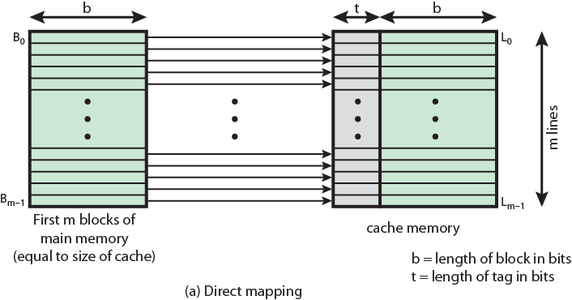
Direct Mapping from Cache to Main Memory

Slide 32
Direct Mapping
Cache Line Table
Cache line | Main Memory blocks held in cache
0 | 0 | m | 2m | 3m | … | 2^{s}-m
1 | 1 | m+1 | 2m+1 | 3m+1 | … | 2^{s}-m+1
2 | 2 | m+2 | 2m+2 | 3m+2 | … | 2^{s}-m+2
3 | 3 | m+3 | 2m+3 | 3m+3 | … | 2^{s}-m+3
… | … | … | … | … | … | …
m-1 | m-1 | 2m-1 | 3m-1 | 4m-1 | … | 2^{s}-1

Slide 33
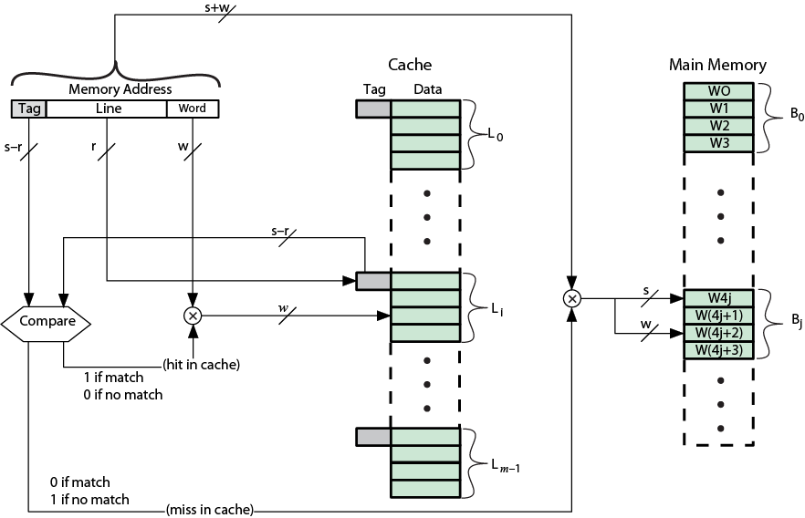
Direct Mapping Cache Organization

Slide 34
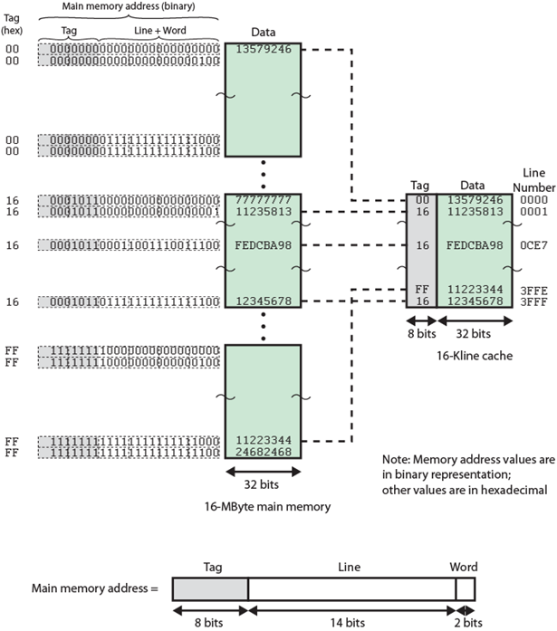
Direct
Mapping
Example

Slide 35
Direct Mapping Summary
Address length = (s + w) bits
Number of addressable units = 2^{s+w} words or bytes
Block size = line size = 2^{w} words or bytes
Number of blocks in main memory
= 2^{s+w}/2^{w} = 2^{s}
Number of lines in cache = m = 2^{r}
Size of tag = (s – r) bits

Slide 37
Direct Mapping pros & cons
Simple
Inexpensive
Fixed location for given block
  If a program accesses 2 blocks that map to the same line repeatedly, cache misses are very high. Hence threshing occurs.

Slide 38
Victim Cache
Lower miss penalty
Remember what was discarded
  Already fetched
  Use again with little penalty
Fully associative
4 to 16 cache lines
Between direct mapped L1 cache and next memory level

Slide 39
Associative Mapping
A main memory block can load into any line of cache
Memory address is interpreted as tag and word
Tag uniquely identifies block of memory
Every line’s tag is examined for a match
Cache searching gets expensive

Slide 40
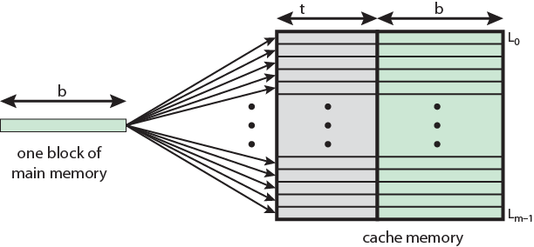
Associative Mapping from
Cache to Main Memory

Slide 41
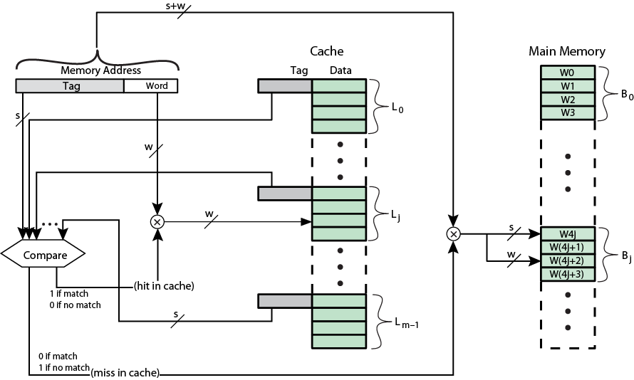
Fully Associative Cache Organization

Slide 42
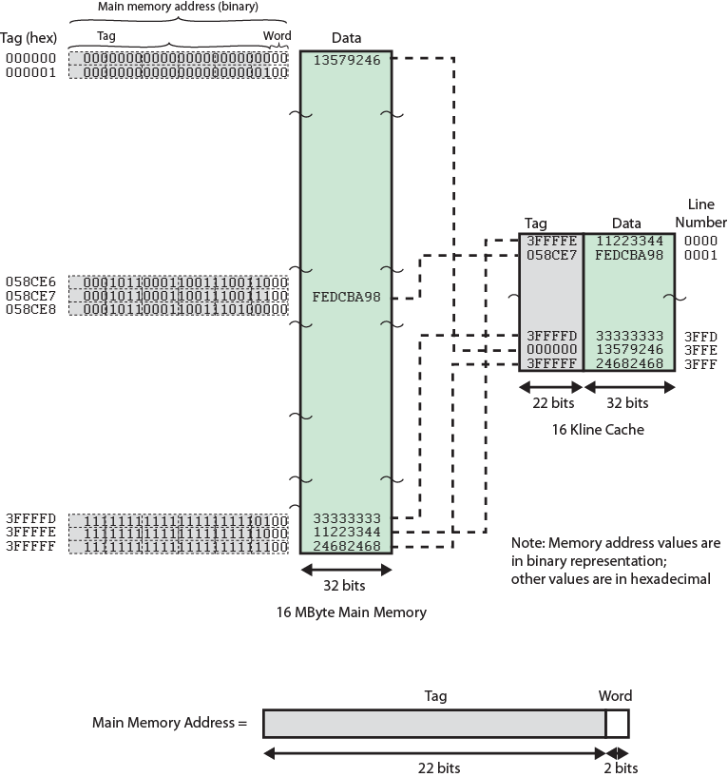
Associative
Mapping
Example

Slide 44
Associative Mapping
Address Structure
Word
2 bit
Tag 22 bit
22 bit tag stored with each 32 bit block of data
Compare tag field with tag entry in cache to check for hit
Least significant 2 bits of address identify which 8 bit word is required from 32 bit data block
e.g.
  Byte Address:Data Tag:Data Cache line
  FFFFFC:24 3FFFFF:24672988 ANY LINE
  FFFFFD:67
  FFFFFE:29
  FFFFFF:88

Slide 45
Associative Mapping Summary
Address length = (s + w) bits
Number of addressable units = 2^{s+w} words or bytes
Block size = line size = 2^{w} words or bytes
Number of blocks in main memory
= 2^{s+w}/2^{w} = 2^{s}
Number of lines in cache = undetermined
Size of tag = s bits

Slide 46
Set Associative Mapping
Cache is divided into a number of sets
Each set contains a number of lines
A given block maps to any line in a given set
  e.g. Block B can be in any line of set i
e.g. 2 lines per set
  2 way associative mapping
  A given block can be in one of 2 lines in only one set

Slide 47
Set Associative Mapping
Example
13 bit set number
Block number in main memory is modulo 2¹³
000000, 00A000, 00B000, 00C000 … map to same set

Slide 48
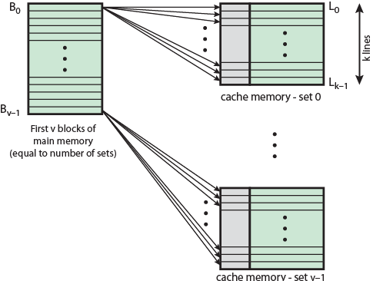
Mapping From Main Memory to Cache: v Associative

Slide 49
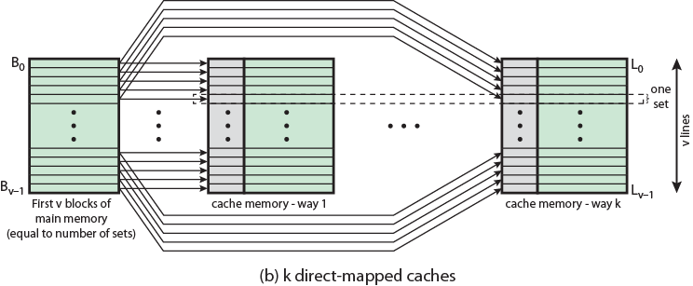
Mapping From Main Memory to Cache: k-way Associative

Slide 50
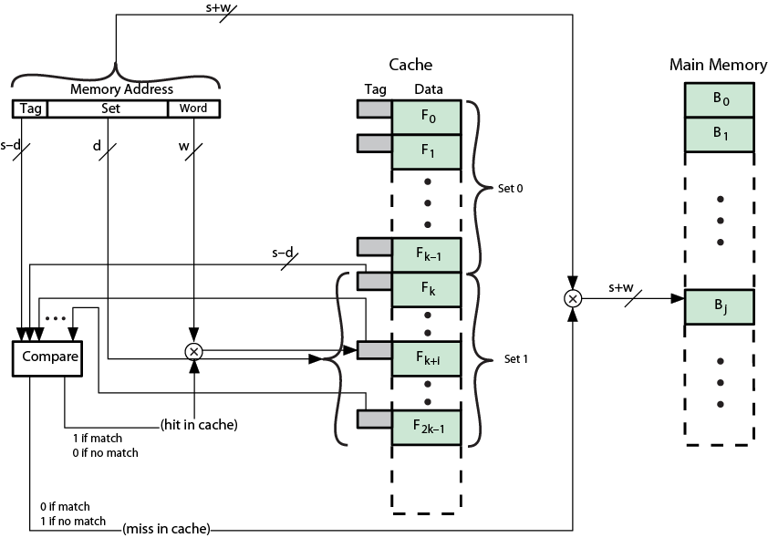
K-Way Set Associative Cache Organization

Slide 51
Set Associative Mapping
Address Structure
Word
2 bit
Tag 9 bit
Set 13 bit
Use set field to determine cache set to look in
Compare tag field to see if we have a hit
e.g
  Address Tag:Data Set number
  [S-d]:[d+w]
  1FF:7FFC 1FF: 23456787 1FFF
  001:7FFC 001:11223344 1FFF

Slide 52
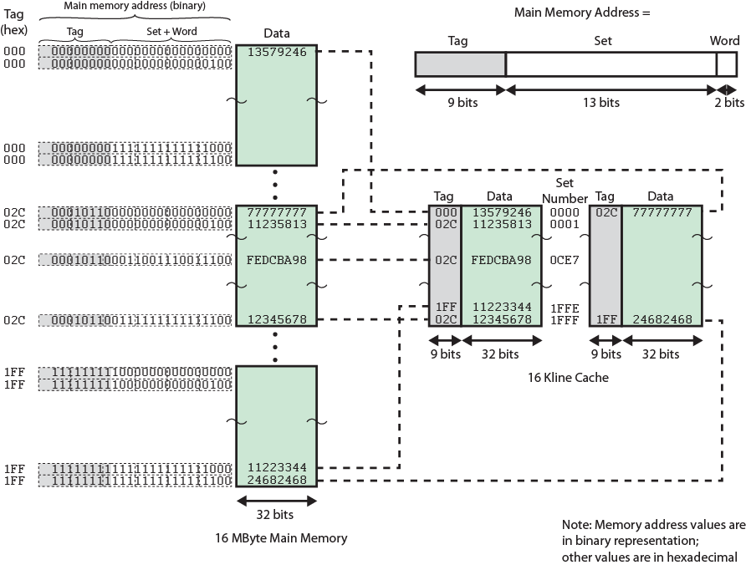
Two Way Set Associative Mapping Example

Slide 53
Set Associative Mapping Summary
RAM
Address length = (s + w) bits
Number of addressable units = 2^{s+w} words or bytes
Block size = line size = 2^{w} words or bytes
CACHE
Number of blocks in main memory = 2^{s}
Number of lines in a set = k
Number of sets in cache = v = 2^{d}
Number of lines in cache = kv = k * 2^{d}
Size of tag = (s – d) bits

Slide 54
Direct and Set Associative Cache
Performance Differences
Significant up to at least 64kB for 2-way
Difference between 2-way and 4-way at 4kB much less than 4kB to 8kB
Cache complexity increases with associativity
Not justified against increasing cache to 8kB or 16kB
Above 32kB gives no improvement
(simulation results)

Slide 55
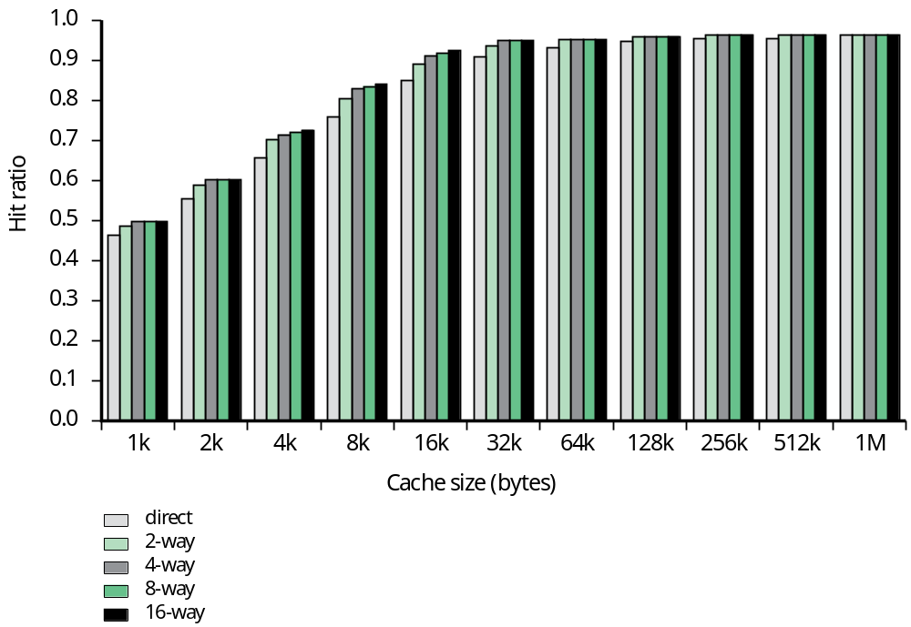
Figure 4.16
Varying Associativity over Cache Size

Slide 56
Replacement Algorithms (1)
Direct mapping
No choice
Each block only maps to one line
Replace that line

Slide 57
Replacement Algorithms (2)
Associative & Set Associative
Hardware implemented algorithm (speed)
Least Recently used (LRU)
e.g. in 2 way set associative
  Which of the 2 block is lru?
First in first out (FIFO)
  replace block that has been in cache longest
Least frequently used
  replace block which has had fewest hits
Random

Slide 58
Write Policy
Must not overwrite a cache block unless main memory is up to date
Multiple CPUs may have individual caches
I/O may address main memory directly

Slide 59
Write through (cache writes are done in RAM as well)
All writes go to main memory as well as cache
Multiple CPUs can monitor main memory traffic to keep local (to CPU) cache up to date
Lots of traffic
Slows down writes
Remember bogus write through caches!

Slide 60
Write back (when replacing)
Updates initially made in cache only
Update bit for cache slot is set when update occurs
If block is to be replaced, write to main memory only if update bit is set
Other caches get out of sync
I/O must access main memory through cache
N.B. 15% of memory references are writes

Slide 62
Write Policies involving I/O
Write-through cache directs write I/O onto cache and through to underlying permanent storage before confirming I/O completion to the host. This ensures data updates are safely stored on, for example, a shared storage array, but has the disadvantage that I/O still experiences latency based on writing to that storage. Write-through cache is good for applications that write and then re-read data frequently as data is stored in cache and results in low read latency.
Write-around cache is a similar technique to write-through cache, but write I/O is written directly to permanent storage, bypassing the cache. This can reduce the cache being flooded with write I/O that will not subsequently be re-read, but has the disadvantage is that a read request for recently written data will create a “cache miss” and have to be read from slower bulk storage and experience higher latency.
Write-back cache is where write I/O is directed to cache and completion is immediately confirmed to the host. This results in low latency and high throughput for write-intensive applications, but there is data availability exposure risk because the only copy of the written data is in cache. Suppliers have added resiliency with products that duplicate writes. Users need to consider whether write-back cache solutions offer enough protection as data is exposed until it is staged to external storage. Write-back cache is the best performing solution for mixed workloads as both read and write I/O have similar response time levels.

Slide 63
Line Size
Retrieve not only desired word but a number of adjacent words as well
Increased block size will increase hit ratio at first
  the principle of locality
Hit ratio will decreases as block becomes even bigger
  Probability of using newly fetched information becomes less than probability of reusing replaced
Larger blocks
  Reduce number of blocks that fit in cache
  Data overwritten shortly after being fetched
  Each additional word is less local so less likely to be needed
No definitive optimum value has been found
8 to 64 bytes seems reasonable
For HPC systems, 64- and 128-byte most common

Slide 64
Multilevel Caches
High logic density enables caches on chip
  Faster than bus access
  Frees bus for other transfers
Common to use both on and off chip cache
  L1 on chip, L2 off chip in static RAM
  L2 access much faster than DRAM or ROM
  L2 often uses separate data path
  L2 may now be on chip
  Resulting in L3 cache
    Bus access or now on chip…

Slide 65
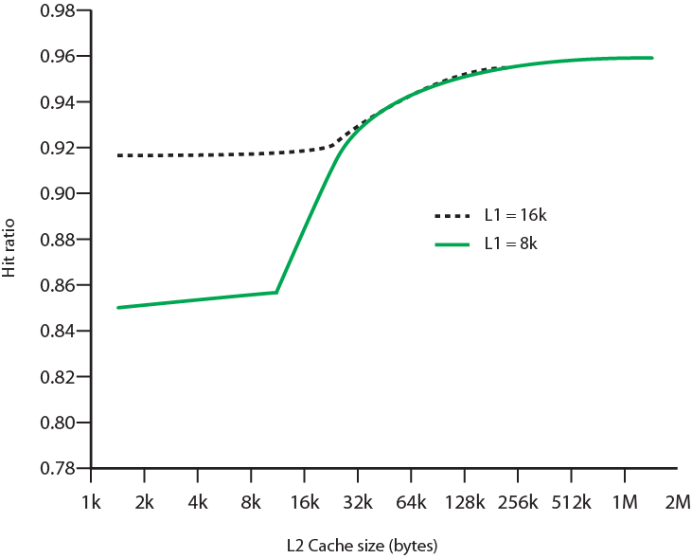
Hit Ratio (L1 & L2) Plot against L2 Cache Size
For 8 kbytes and 16 kbyte L1

Slide 66
Unified v Split Caches
One cache for data and instructions or two, one for data and one for instructions
Advantages of unified cache
  Higher hit rate
    Balances load of instruction and data fetch
    Only one cache to design & implement
Advantages of split cache
  Eliminates cache contention between instruction fetch/decode unit and execution unit
    Important in pipelining

Slide 67
Pentium 4 Cache
80386 – no on chip cache
80486 – 8k using 16 byte lines and four way set associative organization
Pentium (all versions) – two on chip L1 caches
  Data & instructions
Pentium III – L3 cache added off chip
Pentium 4
  L1 caches
    8k bytes
    64 byte lines
    four way set associative
  L2 cache
    Feeding both L1 caches
    256k
    128 byte lines
    8 way set associative
  L3 cache on chip

Slide 68
Intel Cache Evolution
Problem
Solution
Processor on which feature first appears
External memory slower than the system bus.
Add external cache using faster memory technology.
386
Increased processor speed results in external bus becoming a bottleneck for cache access.
Move external cache on-chip, operating at the same speed as the processor.
486
Internal cache is rather small, due to limited space on chip
Add external L2 cache using faster technology than main memory
486
Contention occurs when both the Instruction Prefetcher and the Execution Unit simultaneously require access to the cache. In that case, the Prefetcher is stalled while the Execution Unit’s data access takes place.
Create separate data and instruction caches.
Pentium
Increased processor speed results in external bus becoming a bottleneck for L2 cache access.
Create separate back-side bus that runs at higher speed than the main (front-side) external bus. The BSB is dedicated to the L2 cache.
Pentium Pro
Move L2 cache on to the processor chip.
Pentium II
Some applications deal with massive databases and must have rapid access to large amounts of data. The on-chip caches are too small.
Add external L3 cache.
Pentium III
Move L3 cache on-chip.
Pentium 4

Slide 69
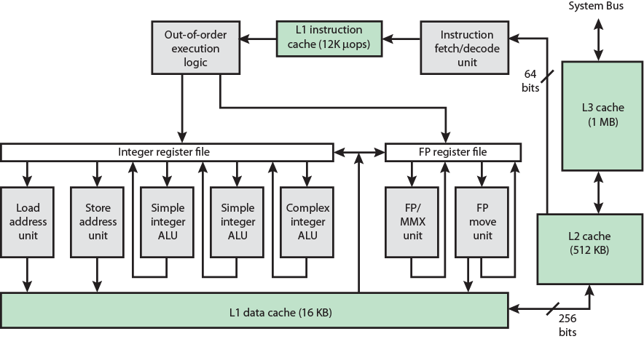
Pentium 4 Block Diagram

Slide 70
Pentium 4 Core Processor
Fetch/Decode Unit
  Fetches instructions from L2 cache
  Decode into micro-ops
  Store micro-ops in L1 cache
Out of order execution logic
  Schedules micro-ops
  Based on data dependence and resources
  May speculatively execute
Execution units
  Execute micro-ops
  Data from L1 cache
  Results in registers
Memory subsystem
  L2 cache and systems bus

Slide 71
Pentium 4 Design Reasoning
Decodes instructions into RISC like micro-ops before L1 cache
Micro-ops fixed length
  Superscalar pipelining and scheduling
Pentium instructions long & complex
Performance improved by separating decoding from scheduling & pipelining
  (More later – ch14)
Data cache is write back
  Can be configured to write through
L1 cache controlled by 2 bits in register
  CD = cache disable
  NW = not write through
  2 instructions to invalidate (flush) cache and write back then invalidate
L2 and L3 8-way set-associative
  Line size 128 bytes

Slide 72
ARM Cache Features
Core | Cache Type | Cache Size (kB) | Cache Line Size (words) | Associativity | Location | Write Buffer Size (words)
ARM720T | Unified | 8 | 4 | 4-way | Logical | 8
ARM920T | Split | 16/16 D/I | 8 | 64-way | Logical | 16
ARM926EJ-S | Split | 4-128/4-128 D/I | 8 | 4-way | Logical | 16
ARM1022E | Split | 16/16 D/I | 8 | 64-way | Logical | 16
ARM1026EJ-S | Split | 4-128/4-128 D/I | 8 | 4-way | Logical | 8
Intel StrongARM | Split | 16/16 D/I | 4 | 32-way | Logical | 32
Intel Xscale | Split | 32/32 D/I | 8 | 32-way | Logical | 32
ARM1136-JF-S | Split | 4-64/4-64 D/I | 8 | 4-way | Physical | 32

Slide 73
ARM Cache Organization
Small FIFO write buffer
  Enhances memory write performance
  Between cache and main memory
  Small c.f. cache
  Data put in write buffer at processor clock speed
  Processor continues execution
  External write in parallel until empty
  If buffer full, processor stalls
  Data in write buffer not available until written
    So keep buffer small

Slide 74
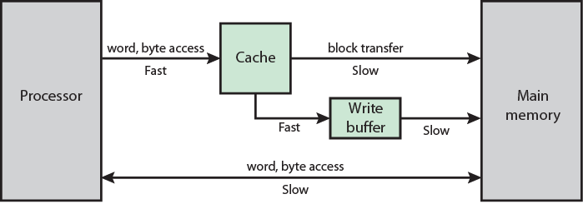
ARM Cache and Write Buffer Organization

Slide 75
Internet Sources
Manufacturer sites
  Intel
  ARM
Search on cache

